Slide 1
CE 101: ENVIRONMENTAL SCIENCE

Slide 2
QUERIES
NEED OF CE 101?
Relation with CE 101?
Symbiotic or Parasitic ?
Can undevelopment solve the issues?
How close are you with CE 101?

Slide 3
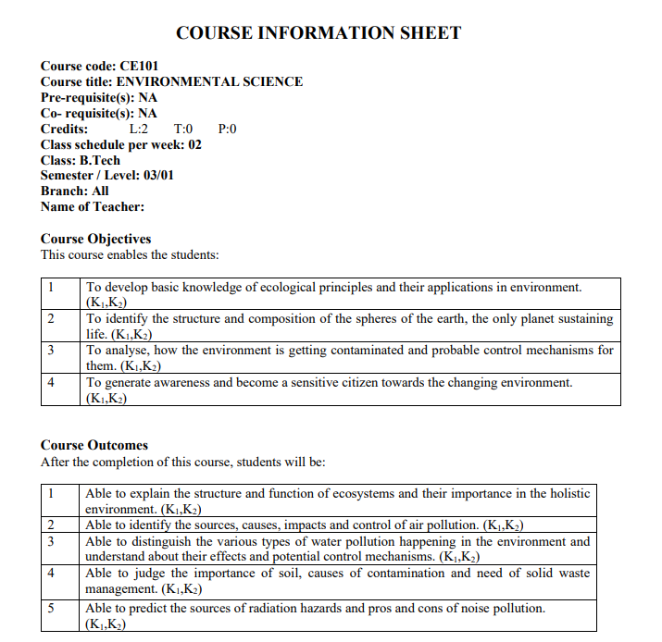

Slide 4
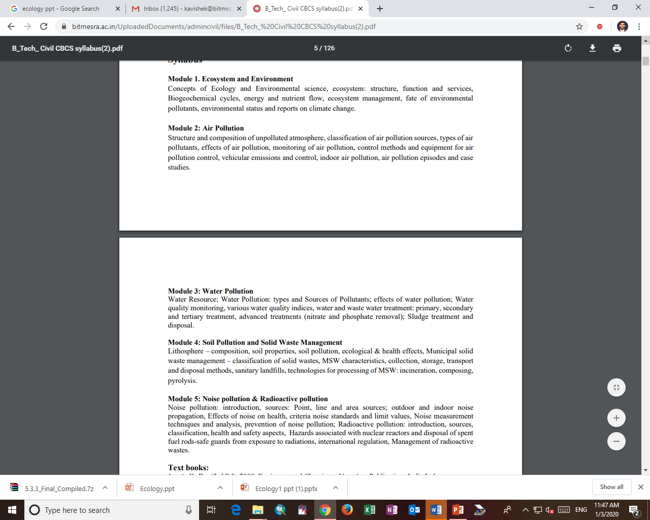
Text books:
1. A, K. De. (3rd Ed). 2008. Environmental Chemistry. New Age Publications India Ltd.
2. R. Rajagopalan. 2016. Environmental Studies: From Crisis to Future by, 3rd edition, Oxford University Press.
3. Eugene P. Odum. 1971. Fundamentals of Ecology (3rd ed.) -. WB Sunders Company, Philadelphia.
4. C. N. Sawyer, P. L. McCarty and G. F. Parkin. 2002. Chemistry for Environmental Engineering and Science. John Henry Press.
5. S.C. Santra. 2011. Environmental Science. New Central Book Agency.
Reference books:
1. D.W. Conell. Basic Concepts of Environmental Chemistry, CRC Press.
2. Peavy, H.S, Rowe, D.R, Tchobanoglous, G. Environmental Engineering, Mc-Graw - Hill International
3. G.M. Masters & Wendell Ela. 1991. Introduction to Environmental Engineering and Science, PHI Publishers.

Slide 5
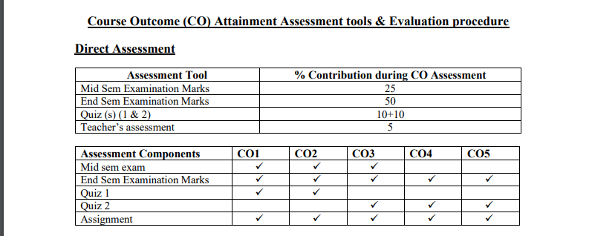
Assessment Methods:

Slide 6
Ecology
Ecology- The study of the relationships between different species in a given area.
Biosphere- Sphere of the Earth in which all living things exist. Is found from the atmosphere all the way into the lithosphere.

Slide 7
Level of Organization
Species- a group of organisms which can interbreed and produce fertile offspring
Population- Groups of individuals of a certain species living in a certain area
Community- Different populations that live in the same area.
Ecosystem- Collection of both the community and the abiotic factors in a certain area
Biome- Group of ecosystems that have the same climatic conditions

Slide 8
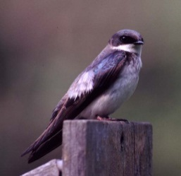
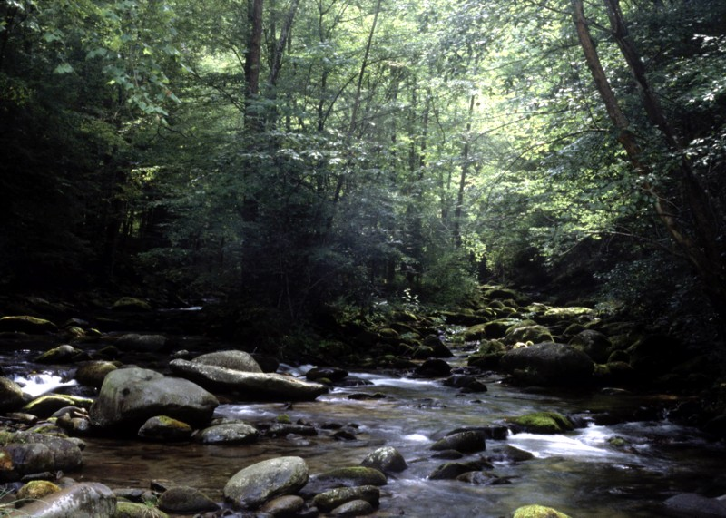
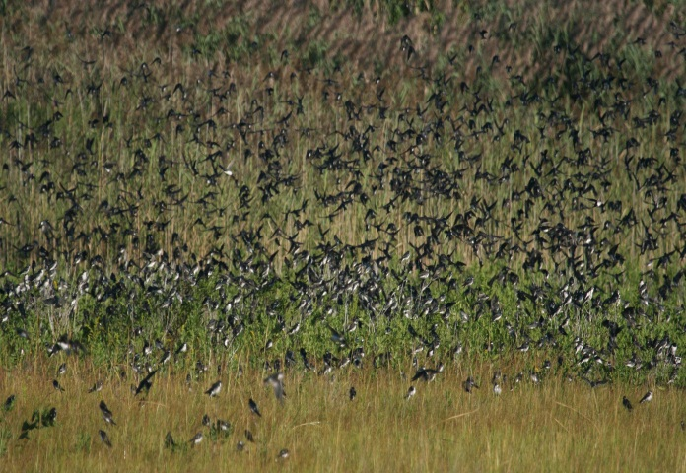
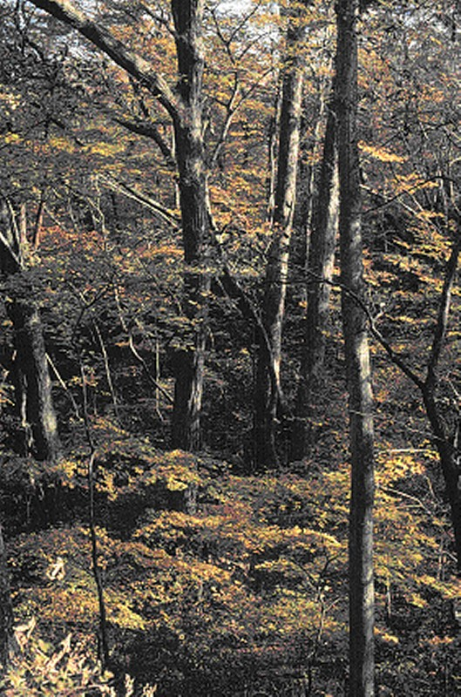
Individual
Population
Ecosystem
Community

Slide 9
Scientific Methods
We can’t do experiments on whole, natural ecosystems
Instead we use several tools to explore ecosystems:
  Observations- We watch and take detailed notes about an ecosystem
  Experimenting-Taking an artificial environment and using the scientific method on it.
  Modeling- Using computers to show what has happened and what will happen in an ecosystem.

Slide 10
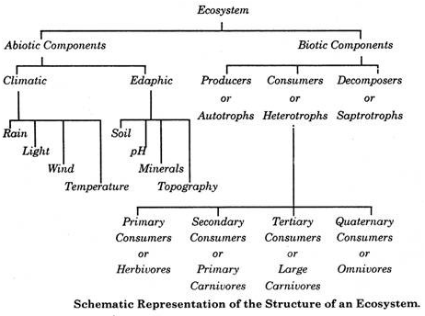
Ecosystem Structure

Slide 11
Structure and Function of an Ecosystem:
Each ecosystem has two main components:
(1) Abiotic
(2) Biotic
(1) Abiotic Components:
The non living factors or the physical environment prevailing in an ecosystem form the abiotic components. They have a strong influence on the structure, distribution, behaviour and inter-relationship of organisms.
Abiotic components are mainly of two types:
(a) Climatic Factors:
Which include rain, temperature, light, wind, humidity etc.
ADVERTISEMENTS:
(b) Edaphic Factors:
Which include soil, pH, topography minerals etc.?

Slide 12
The Functions of Abiotic Components
Soils are much more complex than simple sediments. They contain a mixture of weathered rock fragments, highly altered soil mineral particles, organic mat­ter, and living organisms.
Soils provide nutrients, water, a home, and a struc­tural growing medium for organisms.
The vegetation found growing on top of a soil is closely linked to this component of an ecosystem through nutrient cycling.
The atmosphere provides organisms found within ecosystems with carbon di­oxide for photosynthesis and oxygen for respiration.
The processes of evapora­tion, transpiration and precipitation cycle water between the atmosphere and the Earth’s surface.

Slide 13
The Functions of Abiotic Components
Solar radiation is used in ecosystems to heat the atmosphere and to evapo­rate and transpire water into the atmosphere. Sunlight is also necessary for photosynthesis.
Photosynthesis provides the energy for plant growth and me­tabolism, and the organic food for other forms of life.
Most living tissue is composed of a very high percentage of water, up to and even exceeding 90%. The protoplasm of a very few cells can survive if their water content drops below 10%, and most are killed if it is less than 30-50%.
Water is the medium by which mineral nutrients enter and are trans-located in plants. It is also necessary for the maintenance of leaf turgidity and is required for photosynthetic chemical reactions. Plants and animals receive their water from the Earth’s surface and soil. The original source of this water is precipita­tion from the atmosphere.

Slide 14
Biotic Components
(A) Producers
(B) Consumers
(C) Decomposers or Reducers.
(A) Producers:
The green plants have chlorophyll with the help of which they trap solar energy and change it into chemical energy of carbohydrates using simple inorganic compounds namely water and carbon dioxide. This process is known as photo­synthesis. As the green plants manufacture their own food they are known as Autotrophs (i.e. auto = self, trophos = feeder)
The chemical energy stored by the producers is utilised partly by the producers for their own growth and survival and the remaining is stored in the plant parts for their future use.
(B) Consumers:
The animals lack chlorophyll and are unable to synthesise their own food. There­fore, they depend on the producers for their food. They are known as heterotrophs (i.e. heteros = other, trophos = feeder)

Slide 15
The consumers are of four types, namely:
(i) Primary Consumers or First Order Consumers or Herbivores:
These are the animals which feed on plants or the producers. They are called her­bivores. Examples are rabbit, deer, goat, cattle etc.
(ii) Secondary Consumers or Second Order Consumers or Primary Carnivores:
The animals which feed on the herbivores are called the pri­mary carnivores. Examples are cats, foxes, snakes etc.
(iii) Tertiary Consumers or Third Order Consumers:
These are the large carnivores which feed on the secondary consumers. Example are Wolves.
iv). Omnivores: These are the largest carnivores which feed on the tertiary consumers and are not eaten up by any other animal. Examples are lions and tigers.
(C) Decomposers or Reducers:
Bacteria and fungi belong to this category. They breakdown the dead organic materials of producers (plants) and consumers (animals) for their food and re­lease to the environment the simple inorganic and organic substances produced as by-products of their metabolisms.

Slide 16
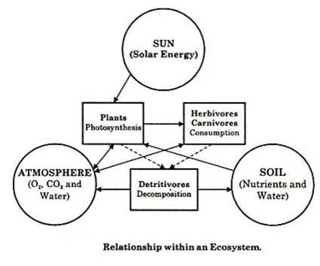
Energy and Matter Flow
Both Energy and Matter flow through an ecosystem
Energy flows into and out of the ecosystem
Matter is usually recycled

Slide 17
Energy
All energy from an ecosystem comes from the sun, originally
Plants convert sunlight into chemical energy
Other organisms eat plants and each other for that stored sunlight energy

Slide 18
Thus the principal steps in the operation of ecosystem are as follows:
(1) Reception of radiant energy of sun,
(2) Manufacture of organic materials from inorganic ones by producers,
(3) Consumption of producers by consumers and further elaboration of consumed materials; and.
(4) After the death of producers and consumers, complex organic compounds are degraded and finally converted by decomposers and converters into such forms as are suitable for reutilization by producers.

Slide 19
Energy Levels
Producers-Autotrophs (plants) who make their food from the sunlight
Consumers-Organisms that eat other organisms for their energy
  Primary consumers eat only plants
  Secondary consumers eat primary consumers (some also eat plants)
  Tertiary consumers eat secondary consumers

Slide 20
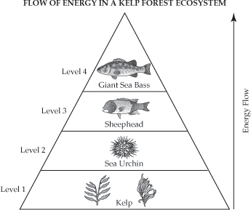
Energy Pyramid
Less energy is transferred to the next trophic level.
This is due to some energy lost due to metabolic activities
Only about 10% of energy is available (in the form of body structure)
to the next trophic level

Slide 21
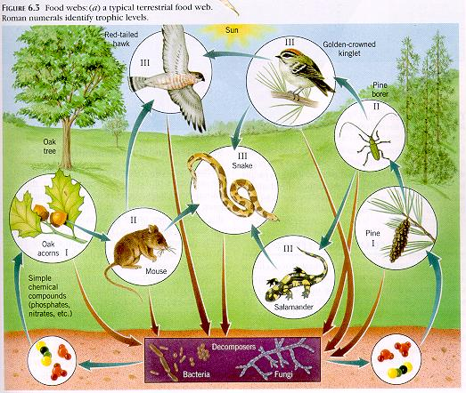
Food Chain/Web
Food chains and webs show the food (and therefore energy) relationship between species in an ecosystem.

Slide 22
Cycles of Matter
Water cycle- Water, through evaporation and condensation, cycles through ecosystems
Carbon Cycle- Carbon travels through ecosystems by photosynthesis and respiration
Nitrogen Cycle- Nitrogen travels through ecosystems by chemical processes
  Nitrogen fixation- Bacteria and fungi take nitrogen from the atmosphere and change it to a form useful to plants
  Denitrification- Other bacterial convert the soil nitrogen back into a gas

Slide 23
Limiting Nutrients
Some nutrients are in short supply in an ecosystem
These nutrients are called limiting nutrients
  E.g. water in a desert ecosystem

Slide 24
Ecological Relationships
Predation- One organism eats another, usually smaller, organism
Symbiosis- Two organisms live very closely together
Mutualism-Type of symbiosis where both organisms benefit
Commensalism- Type of symbiosis where one member benefits, the other is unaffected
Parasitism- Type of symbiosis where one member benefits at the expense of the other

Slide 25
Ecological Succession
Ecological succession is the process by which an ecosystem recovers from some abiotic disaster
There are stages, and at each stage there are distinct species
Two types of succession:
  Primary succession- the ecosystem suffered a total loss, and species from the outside are recolonizing
  Secondary succession- the ecosystem was disturbed, but not totally wiped out, so its own members can recover the disturbed space.

Slide 26
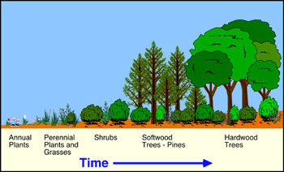
Primary Succession

Slide 27
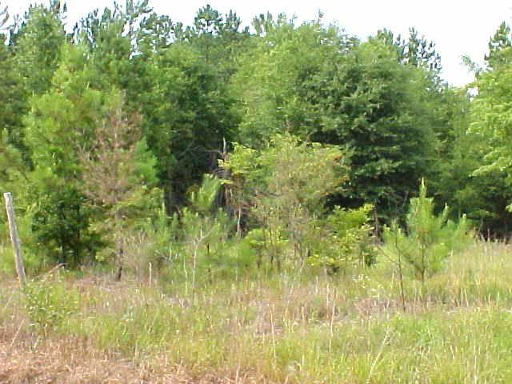
Secondary Succession

